Slide 1
The Power of Authenticity
Why Being Yourself Matters

Slide 2
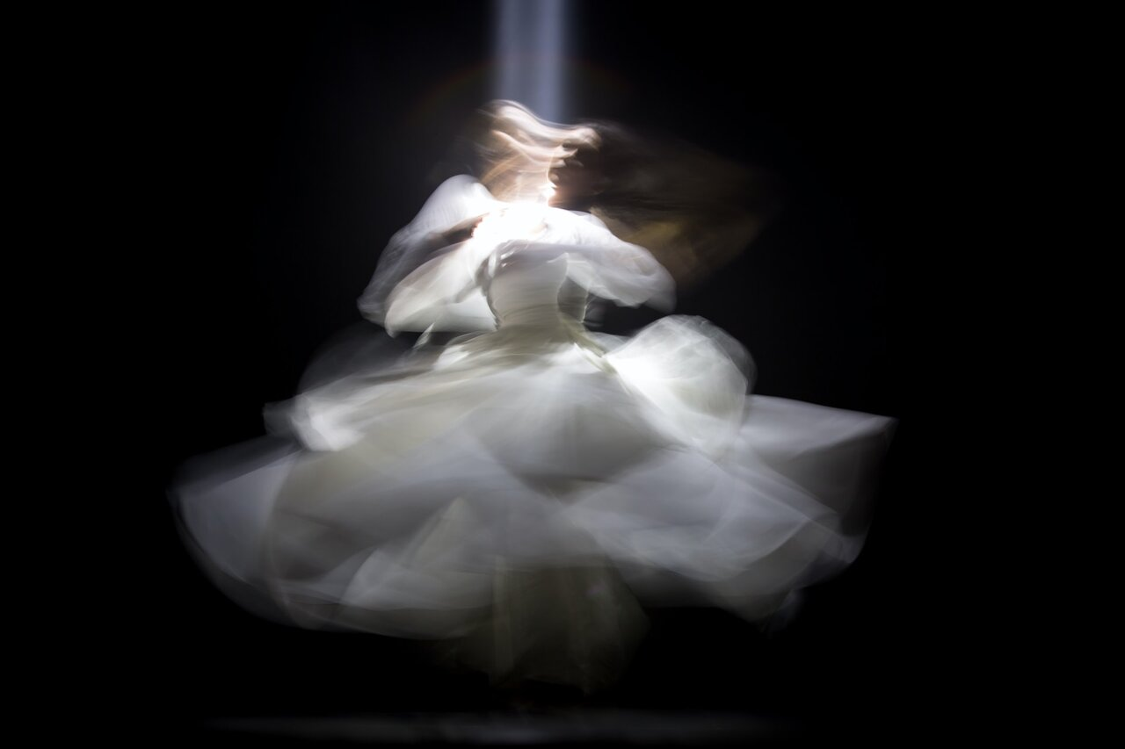
Welcome to today's podcast episode where we delve into the profound importance of being yourself.
Welcome to today's podcast episode where we delve into the profound importance of being yourself.

Slide 3
Why is it important to be yourself?
Being Yourself
True Values, Beliefs, Aspirations
Personal Insecurities
Authenticity
Societal Expectations
Quirks/Preferences

Slide 4
The concept of authenticity and its importance in fostering genuine connections
Authenticity
Trust, Understanding, Mutual Respect
Genuine Connections

Slide 5
The concept of inner peace and fulfillment through being true to oneself
Inner Peace and Fulfillment
This central concept represents the state of contentment and satisfaction that comes from living authentically and aligned with one's true self
Sense of Congruence
This aspect refers to the harmony between one's inner thoughts, feelings, and beliefs, and their outward actions and behaviors. When there is congruence, there is a sense of alignment and authenticity in how one presents themselves to the world.
Liberation from Double Life
This represents the freedom from the burden of living a double life, where one feels compelled to conform to societal expectations or portray a false image of themselves. By embracing authenticity, individuals can shed these layers of pretense and live with integrity and purpose.

Slide 6
The concept of embracing uniqueness and unlocking potential
Pursuit of Passions and Dreams
Unleashing Potential
Embracing Uniqueness

Slide 7
Contrasting Elements of Conformity and Authenticity
Conformity
Authenticity
Pressure to Conform
Act of Rebellion
Risk of Judgment
Courage
Vulnerability
Lack of Individuality
Self-awareness
Inhibition
Resilience
Homogeneity
Rewards

Slide 8
The conclusion by summarizing the key points and call-to-action statements
Being Yourself: A Revolutionary Act
Embrace Uniqueness Celebrate Differences Stand Proudly in Authenticity
Declaration of Self-Worth and Dignity
Dare to Be Yourself Truly Come Alive

Slide 9
Keep Shining Bright
Stay True to Yourself
Thank You

